Slide 1

FIRST FLY AIRPLANE RESERVATION SYSTEM
Book a flight for your desired destination

Slide 2



Prepared by:
Samadrita Mukherjee
(203224-11-0072)
Antarita Das
(203224-11-0070)
Saswati Mukherjee
(203224-11-0065)
Saheli Malakar
(203224-11-0106)
SUPERVISOR NAME :
Mr. Pritam Ghosh

Slide 3



LEARNING NEW TECHNOLOGIES
MOTIVATION
The main motivation for the project comes from our interest to learn new technologies like HTML, CSS, PHP, Javascript, bootstrap etc.
ADDRESSING A REAL WORLD NEED
The Airline industry is a significant sector of global transportation, and an Airplane Reservation System addresses the real-world need for efficient and user-friendly flight booking and management.
ENHANCE CUTOMER EXPERIENCE:
An Airplane Reservation System automates and streamlines the process, reducing manual work and increasing efficiency.

Slide 4


EASY TO BOOK A FLIGHT
SCOPE
Airline reservation system makes the process convenient as passengers don't need to stand in queues & it saves time.
AVAILABILITY OF FLIGHTS
Customer can view all the different flight's availability with different timings for a particular date and place.
.
TRACKING RECORDS OF CUSTOMER
It also makes the work of airline service companies easier by keeping all the records of passenger & if there is any changes in flight, the passengers are promptly informed.

Slide 5



OVERVIEW
Airplane reservation system is designed to meet the demand of customers who are booking a particular flight online to a certain destination. This online platform will make it convenient for customers to book a flight at any point of time. The users can make a new reservation, view flight schedule, and also to cancel the booking as per their wishes. Furthermore, Airline reservation system contains details of the flight such as flight costs, passenger reservations and ticket datasheet records added to the database. Customers do not have to visit at the airline office to make a traveling reservation. This software was designed to eliminate the old manual system .

Slide 6

BACKGROUND OF DEVELOPMENT PROCESS:
The development process of a modern reservation system involves several key steps:
The first step is research. This research helps to identify gaps in the market that a new reservation system can fill.
Once the research phase is complete, the design phase begins. This involves creating a detailed plan for the reservation system.
After the design is finalized, testing begins. This includes both unit testing and integration testing.
Finally, once the system has been thoroughly tested and any bugs or issues have been resolved, it can be implemented and launched.

Slide 7

HARDWARE SPECIFICATION
Intel® Celeron® Processor 7305 (8M Cache, 1.10 GHz)
HDD 20GB Hard Disk Space and above
RAM 2GB and above
SOFTWARE SPECIFICATION
XAMPP Server.
Database MySQL
PHP
HTML & CSS
Javascript
Bootstrap

Slide 8

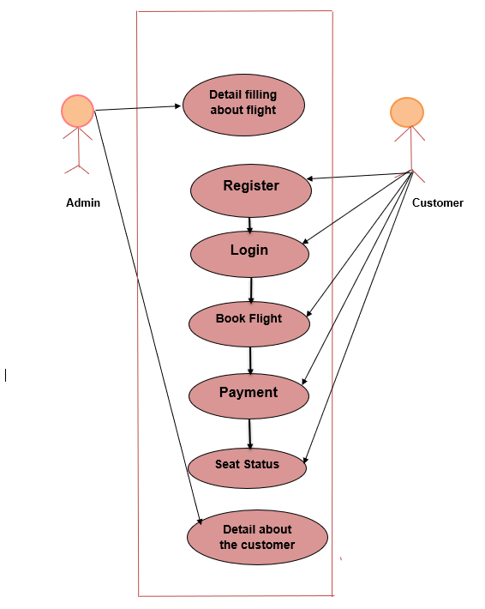

METHODOLOGY/ DESIGN
USE CASE DIAGRAM

Slide 9
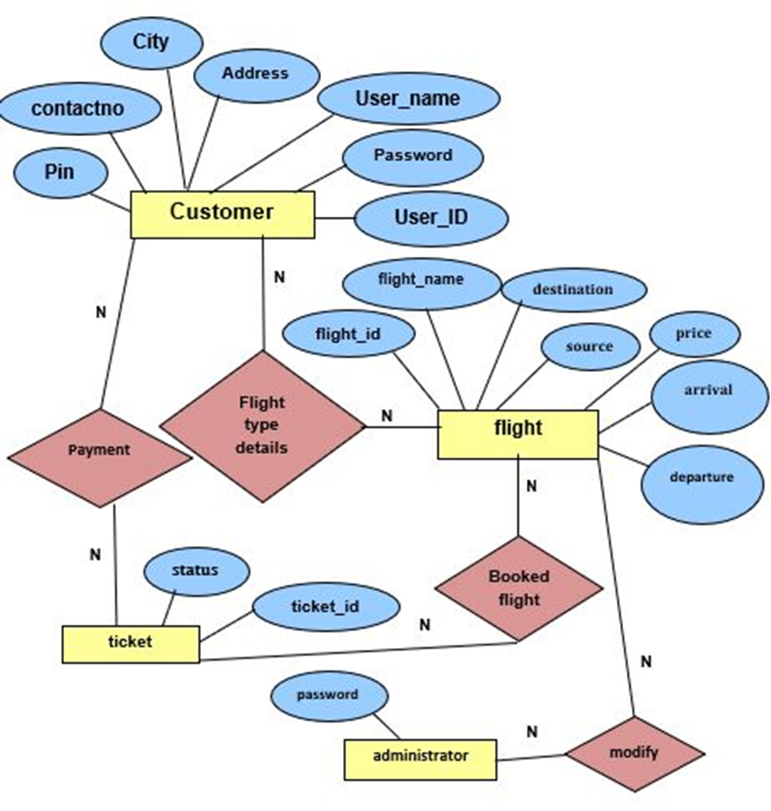
ENTITY RELATIONSHIP DIAGRAM
(ER)

Slide 10
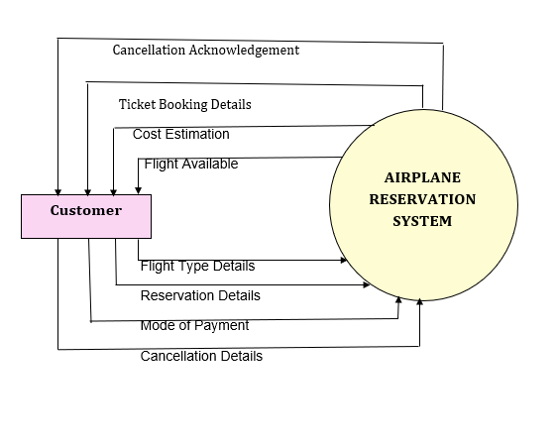
LEVEL O DFD
(USER PANEL)

Slide 11
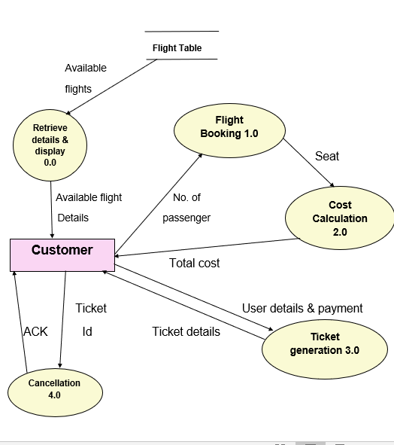
LEVEL 1 DFD
(USER PANEL)

Slide 12
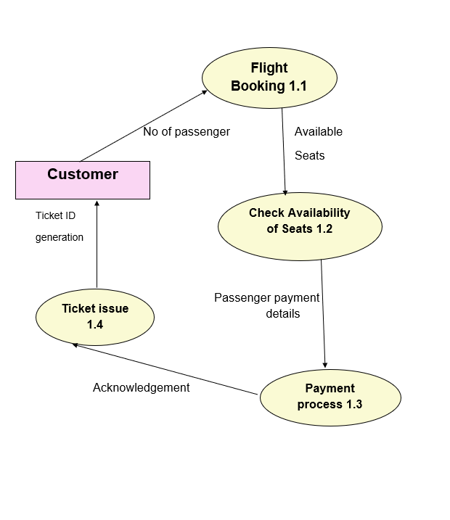
LEVEL 2 DFD
(USER PANEL)

Slide 13

MODULE DESCRIPTION
USER PANEL
Customer login:
User needs to log in to book the flight first.
Customer Registration:
If someone is a first time user and wants to book a flight they need to register to our website.
Password Recovery:
User may create new password via verification code.
Booking Details:
User needs to provide the flight details for the type of flight they want and the available flights will be displayed accordingly.

Slide 14

USER PANEL . . . .
Passenger Details:
The booking procedure is accomplished by providing full passenger information. That is user have to give the details such as the total number of passengers , their age type and gender.
Seat Reservation:
User can reserve their seat as per their convenience. They can see the available seats and if all seats are reserved they have to book another flight.
Payment Process:
After providing the passenger details and choosing seats user have to pay the total cost of booking providing their payment details. The payment is a dummy procedure here.

Slide 15

USER PANEL . . . .
Final Ticket:
After the completion of successful booking user will get their final ticket which consists all the details of their booking. They can download the ticket for future uses.
Cancel Booking:
If any user want then they can cancel their flight booking by simply providing the ticket ID, Which they can get from their ticket details.
Updated Flight Schedule:
User can check the flight schedules updated by the admin with just a click .
About Us:
User can know about our website. This page also has a feedback form where customers can submit their feedback.

Slide 16
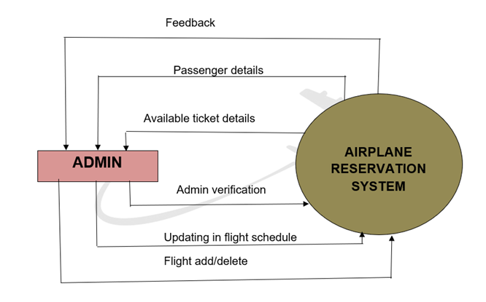
LEVEL O DFD
(ADMIN PANEL)

Slide 17
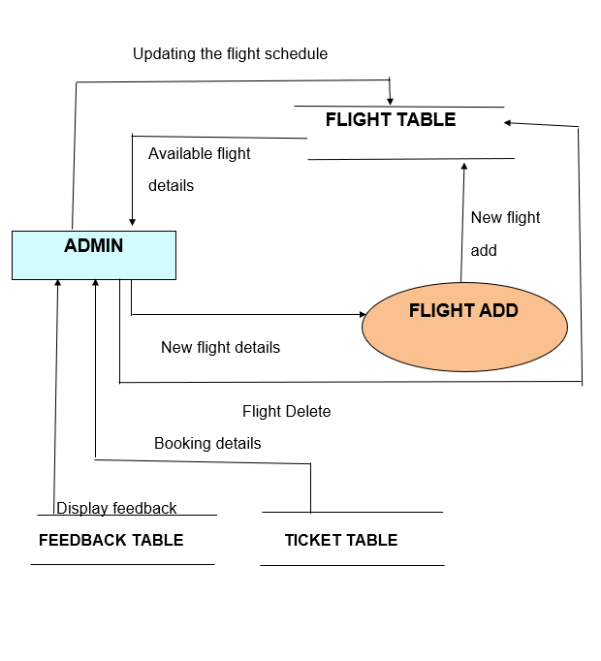
LEVEL 1 DFD
(ADMIN PANEL)

Slide 18

MODULE DESCRIPTION
ADMIN PANEL
Customer details handling:
Admin can view the passenger details and their booking details. And the record is kept private from public
Flight schedule update:
Any changes in the arrival and departure time of the flights is handeled properly by admin.
Customer feedback view:
Customer's feedbacks plays a crucial role for future enhancement of the software. Admin can see the feedback details which help them to make the system more useful.
Flight addition and deletion:
In case of introduction of any new flight or removal of any existing flight, the admin updates the same.

Slide 19
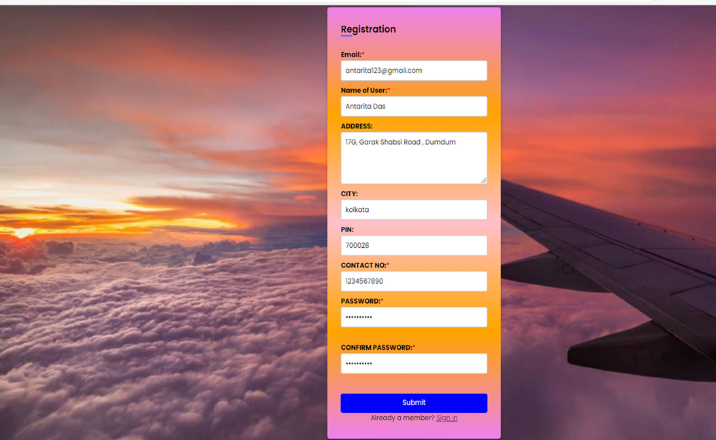
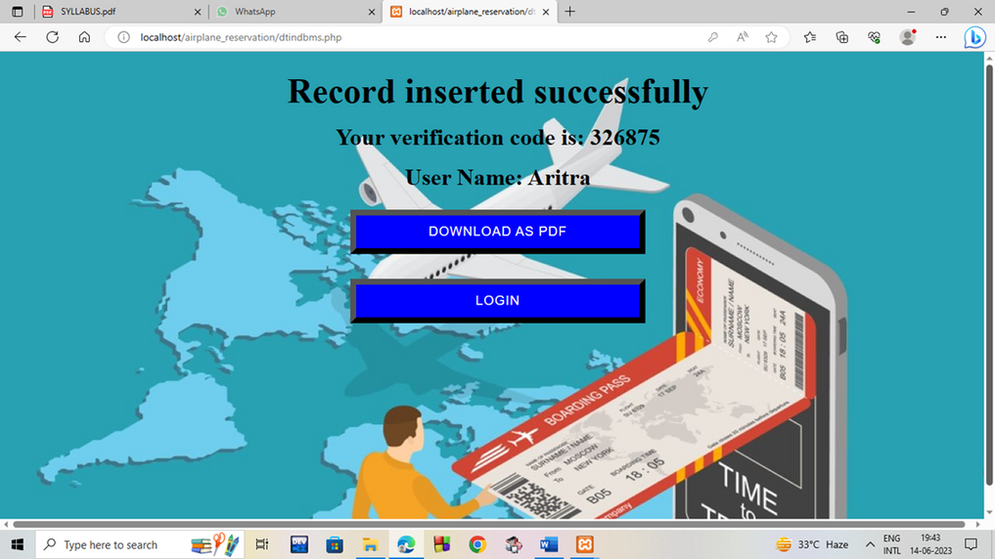
RESULTS AND DISCUSSION

Slide 20
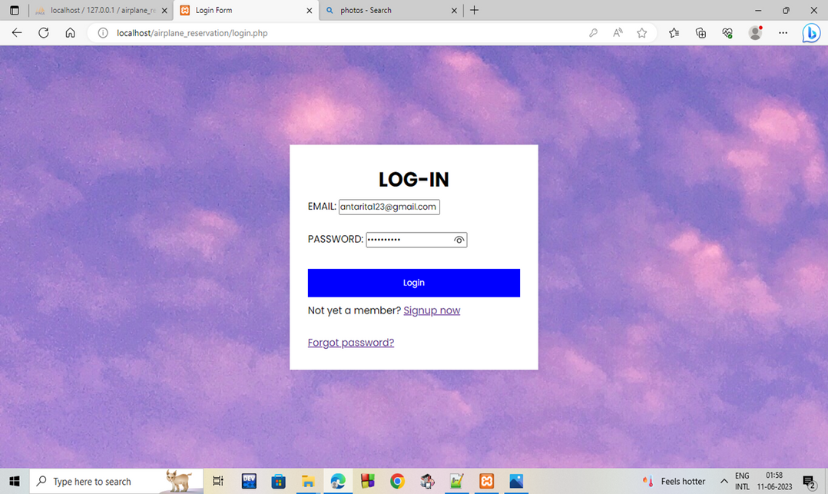
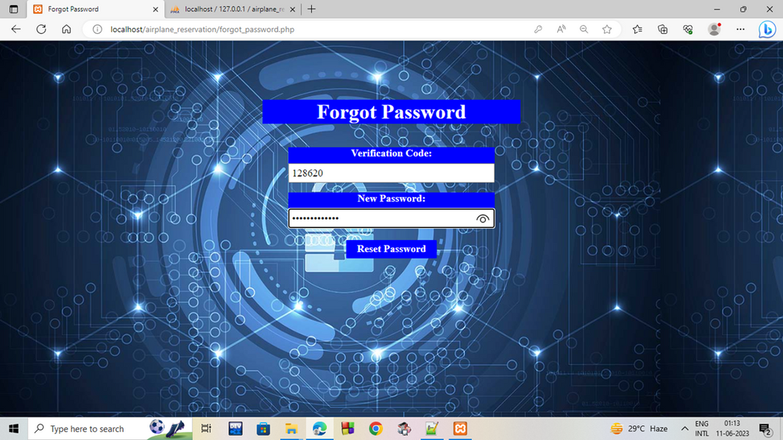
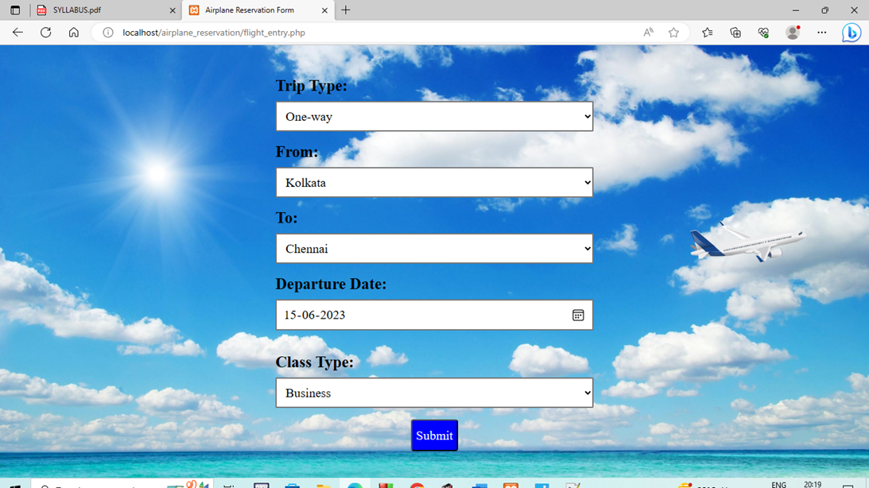
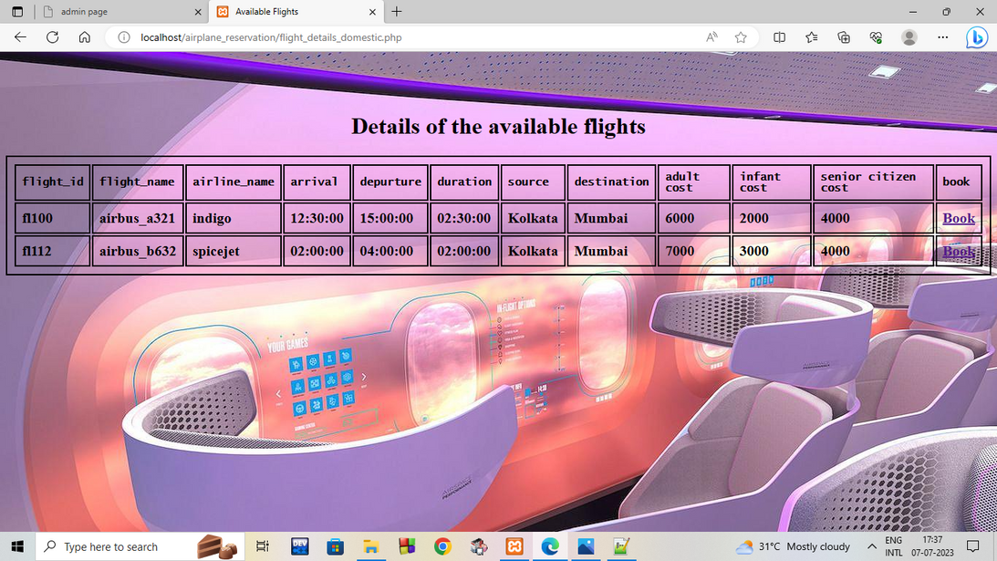

Slide 21
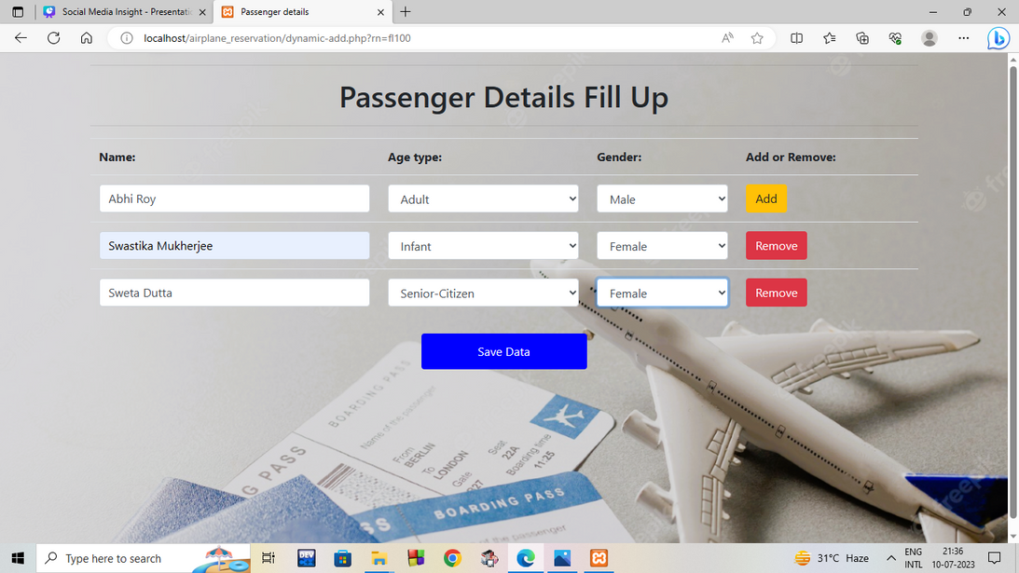
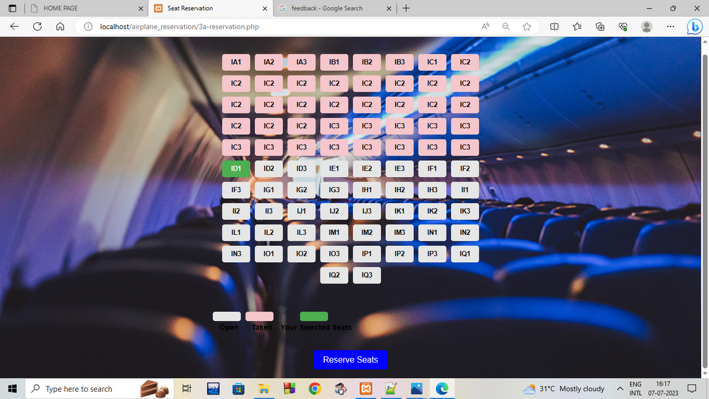
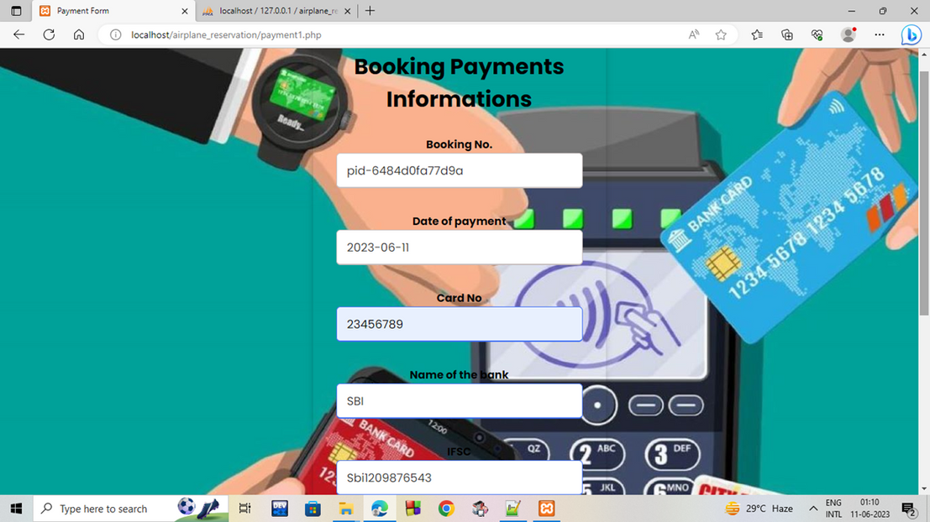
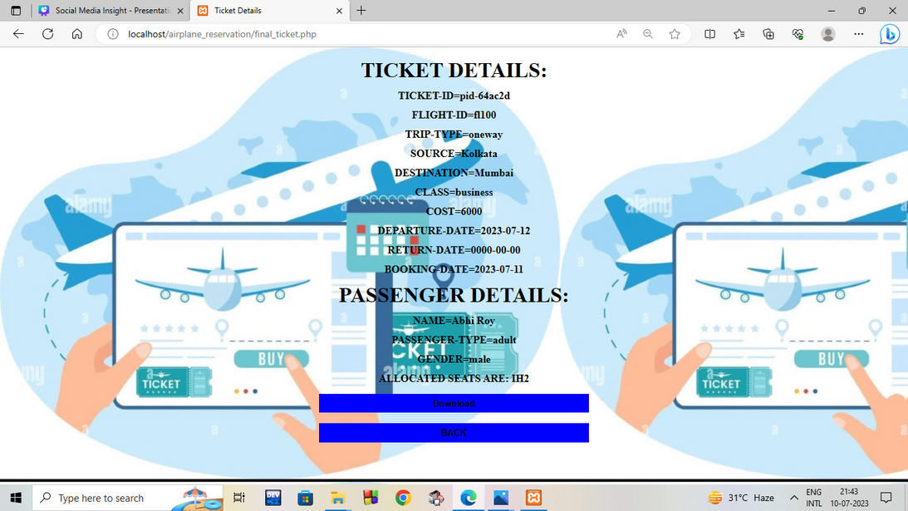

Slide 22
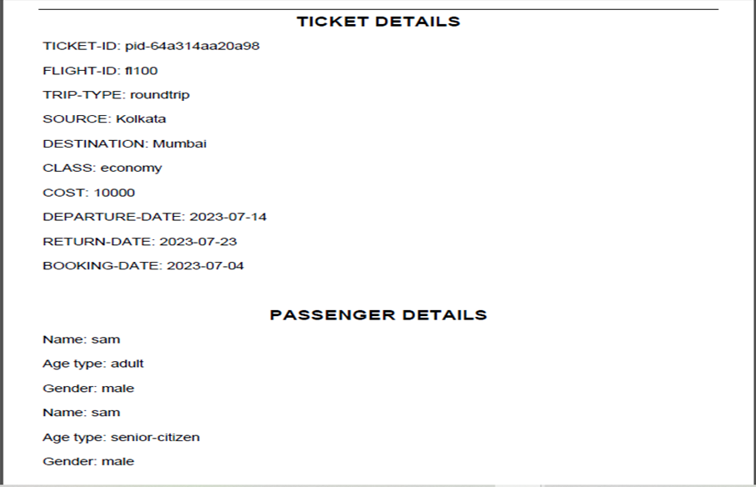
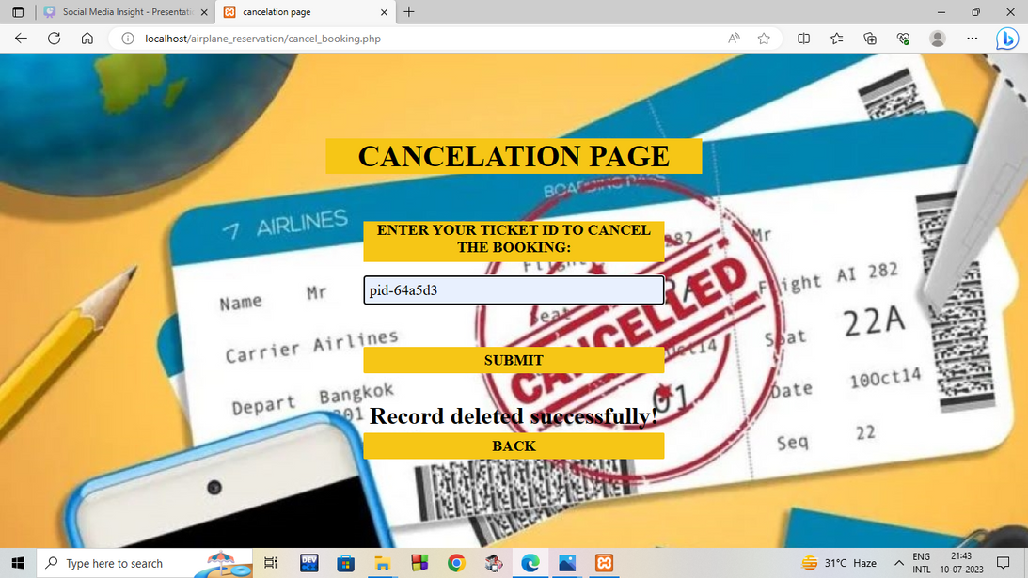
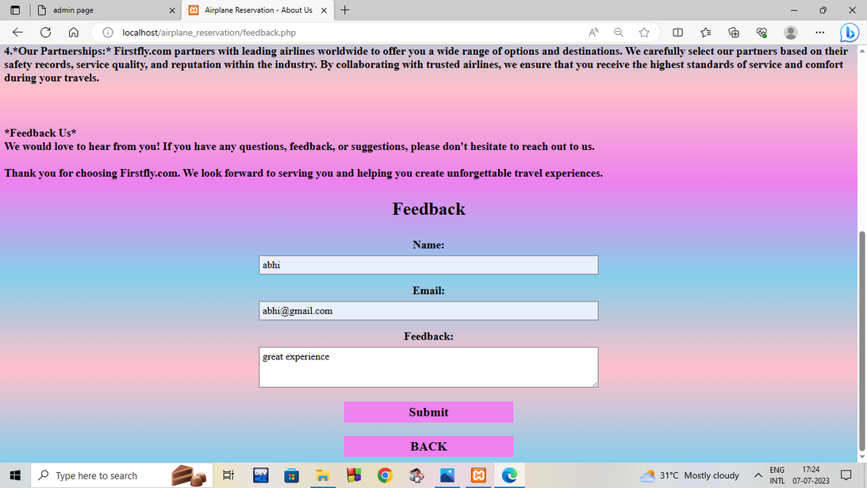
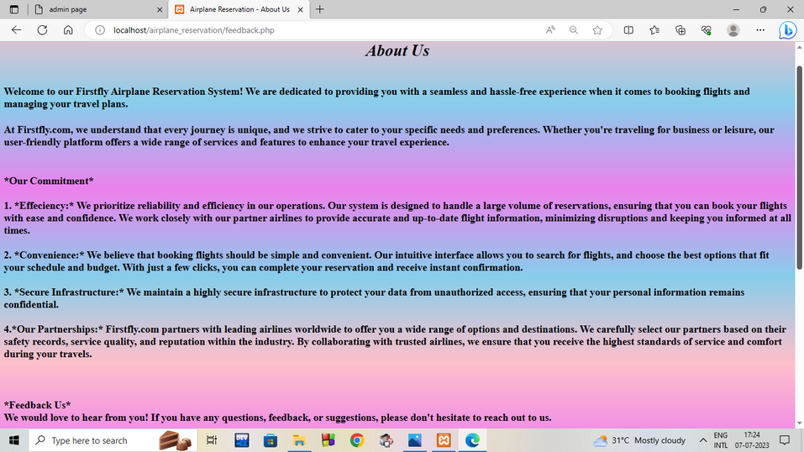

Slide 23
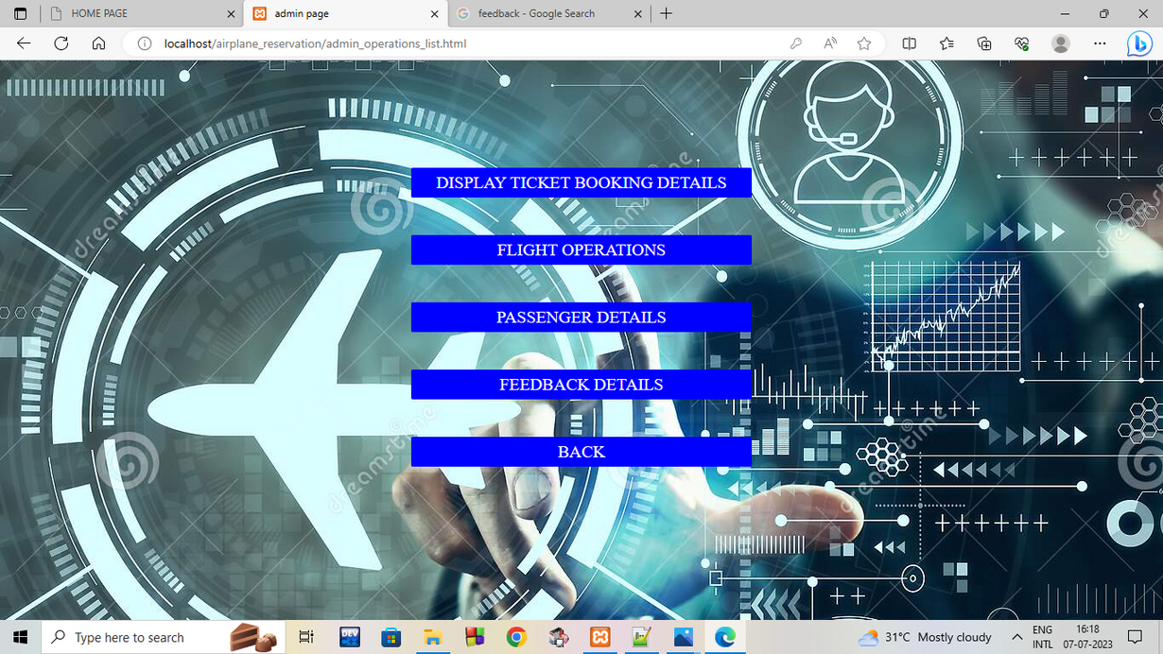
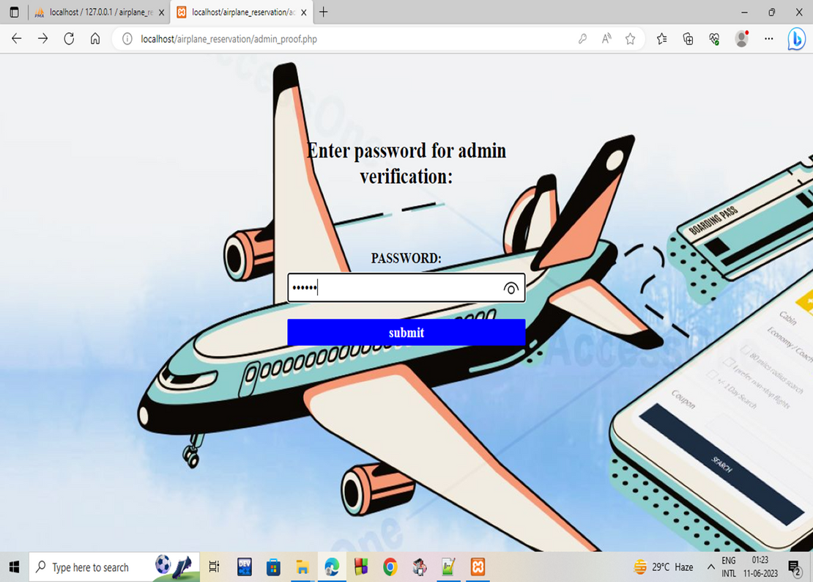
RESULTS AND DISCUSSION

Slide 24
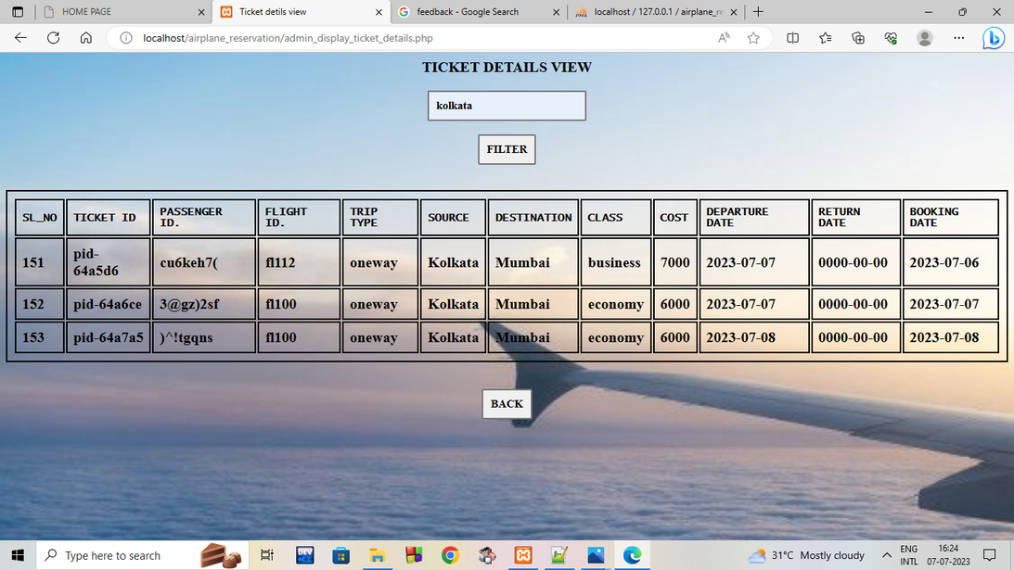
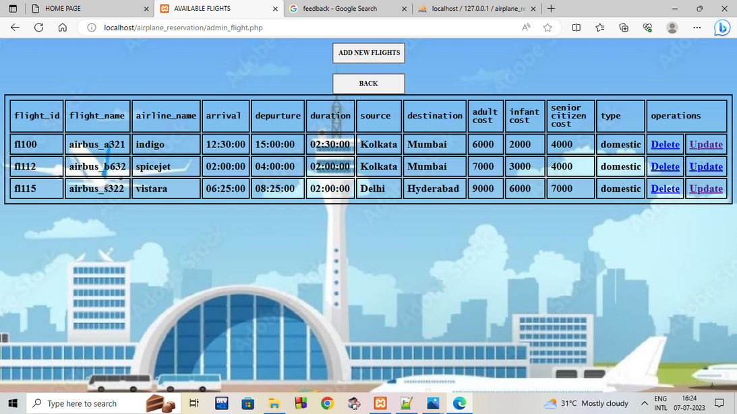
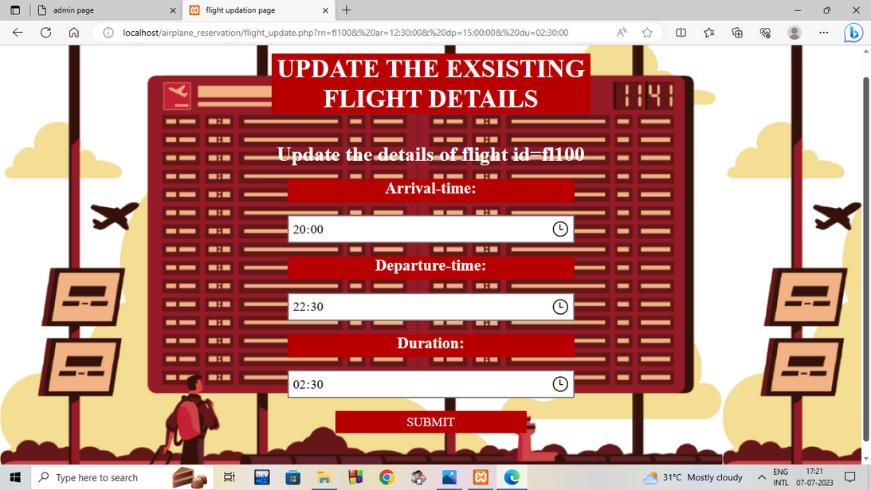
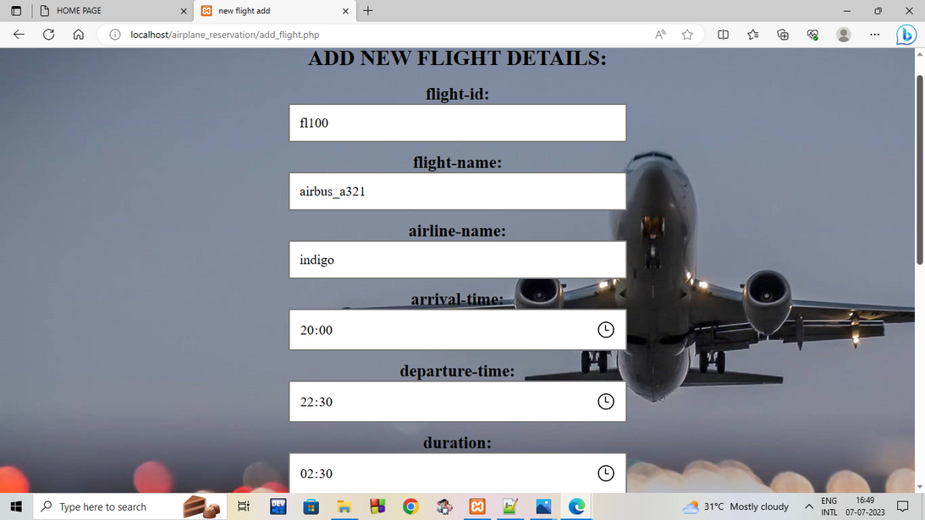

Slide 25
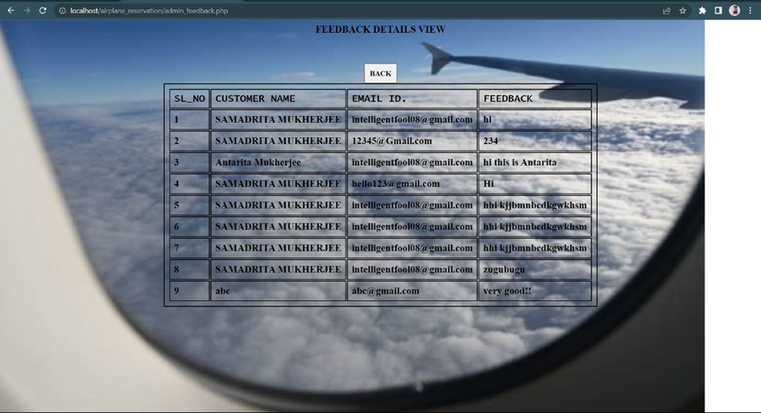
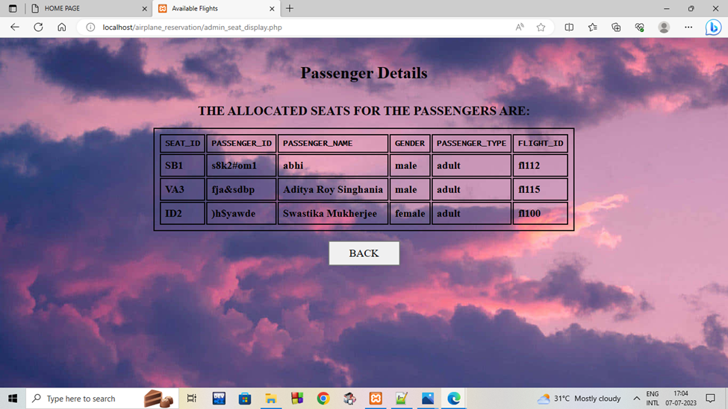

Slide 26


FUTURE SCOPE
Price according to seats is not done yet
Extra facilities such as providing food is not present in this project.
Boarding pass is also not present
We have not use payment gateway for money transaction.

Slide 27
REFERENCES
An Integrated Approach to Software Engineering – Pankaj Jalote
Fundamentals of Software Engineering – Rajib Mall
https://www.tutorialspoint.com/php/index.htm
https://www.w3schools.com/php/
https://www.w3schools.com/howto/howto_js_password_validation.asp
https://www.plus2net.com/php_tutorial/pdf-cell.php
https://www.codexworld.com/send-email-with-attachment-php/
https://www.onlyxcodes.com/2021/04/otp-verification-in-php.html
https://www.w3schools.com/css/css_syntax.ASP

Slide 28
We have seen that the current state of airline reservation has limitations and problems that can be addressed by implementing a modern reservation system. Key features such as real-time availability, and personalized options are crucial for customer resonance. The development process may present challenges, but with careful planning and problem-solving, these can be overcome. Finally, we explored future trends and innovations, emphasizing the importance of user experience in driving customer loyalty and revenue.
CONCLUSION

Slide 29



